Slide 1
Analysis of Indian Stock Market: NIFTY-50 Data
Team - Analytical Avengers
1. Tushar Ahuja
2. Pranav Sethi
3. Akshita Phogat

Slide 2
Introduction
This project explores how current and past data in the Indian stock market are connected. Using new technology and live market info, we want to link past trends to today's market moves. Our aim is to help investors make smarter choices, handle market ups and downs, and spot new chances. We're digging deep to give investors the tools they need to understand stock market changes better and make more confident decisions.
Purpose : The purpose of the project is to provide investors with actionable insights by integrating real-time and historical Indian stock market data and employing advanced statistical methodologies.
What is NIFTY 50 ?
The NIFTY 50 index, representing India's top 50 companies on the National Stock Exchange (NSE), is a key gauge for the Indian stock market. It's calculated by looking at how much these companies are worth, without considering how many shares are available for trading. This gives a fair idea of how different parts of the economy are doing.

Slide 3
Research Questions
Question 1: How can we use past and present data to predict future movements of the Indian stock market?
Question 2: Investigate whether the tone (positive, negative, neutral) of news articles impacts market volatility and the occurrence of price spikes or crashes in the NIFTY-50 index.
Question 3: How can real-time Indian stock market data be efficiently retrieved and integrated into an investor bot to provide timely insights and actionable information for investment decision-making within a short time frame?

Slide 4
Data Source
Real-Time Data: Utilizing Google Finance for real-time stock market data via web scraping and newsdata.io for Sentimental Analysis of latest news for the impact on real-time NIFTY 50 data via API respectively.
Google Finance: https://www.google.com/finance/quote/NIFTY_50:INDEXNSE
newsdata.io: https://newsdata.io/search-news
Historical Data: Sourcing historical stock market data directly from Yahoo Finance in CSV format.
Yahoo Finance: https://finance.yahoo.com/quote/%5ENSEI/history
Relevance of Chosen Data Sources: The selection of data from these sources are crucial due to there credibility and reliability in delivering accurate and timely market information.

Slide 5
Approach
Data Acquisition
Gathering information about NIFTY 50's past and current performance from reliable sources.
Integration of historical and real time data
Combining data on NIFTY 50's past trends with up-to-date information to get a complete picture of its movements.
Data Exploration
Delving into NIFTY 50's data to identify trends, patterns, and anomalies.
Data Preparation
Cleaning and organizing NIFTY 50's data to ensure accuracy and consistency for analysis.
Data Analysis
Analyzing NIFTY 50's data to uncover insights and make informed decisions.
Model Devlopment
Creating predictive models based on NIFTY 50's historical data to forecast future movements.

Slide 6
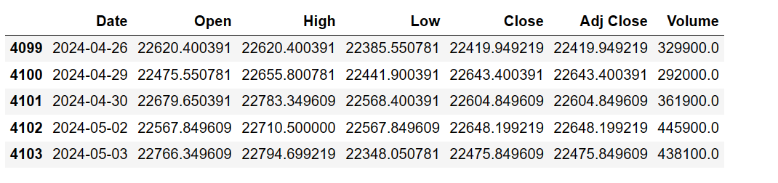
Main Challenge: Merging the data

Slide 7
Data Preparation and Feature Engineering.
Checked for missing values to ensure data integrity and completeness.
Dropped rows with missing values to maintain data quality and reliability.
Dropped missing values in specific columns, targeting columns critical for analysis and decision-making.
Conducted a subsequent check for missing values after removal to confirm data cleanliness.
Implemented data analysis techniques such as extracting Year, Month, and Year-Month from Date to facilitate deeper insights into temporal trends and patterns.

Slide 8
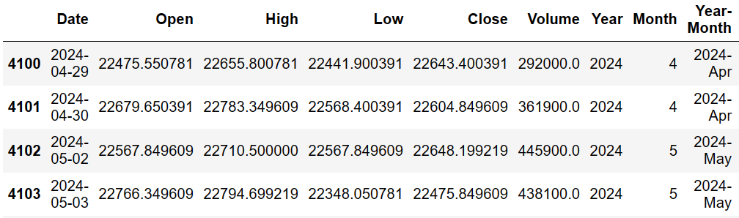
Our Dataset

Slide 9
Exploratory Data Analysis (EDA)
EDA uncovers patterns and relationships in datasets through visualizations and summary statistics.
It guides further analysis and decision-making by providing crucial insights.
EDA involves examining individual variables, exploring relationships between pairs, often using interactive line charts for precise analysis and visualization.

Slide 10
Univariate Analysis
Trend Identification: Line graphs show if stock prices are rising, falling, or stable.
Volatility Assessment: They reveal price fluctuations, indicating volatility and risk.
Seasonal Patterns: Seasonal patterns offer insights into market behavior.
Outlier Detection: Outliers highlight potential anomalies or significant events.
Pattern Recognition: Recognizable patterns aid in predicting future price movements.
Support and Resistance Levels: Support and resistance levels are essential for technical analysis.

Slide 11
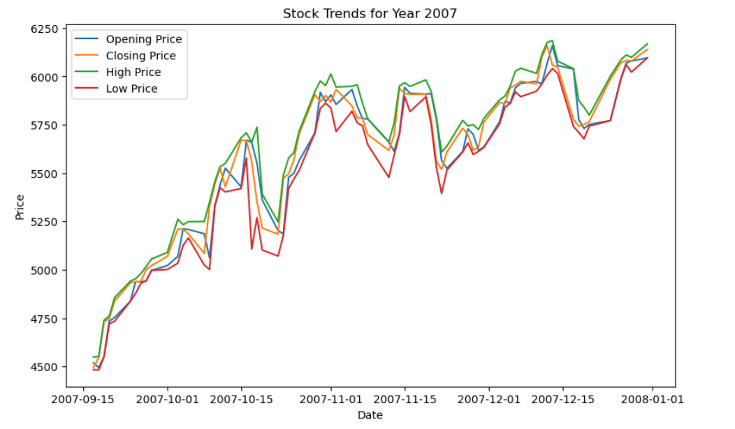
Visualize Trends Year By Year
Year - 2007
Note:- The primary columns for stock market data typically include high, low, close, and open prices.

Slide 12
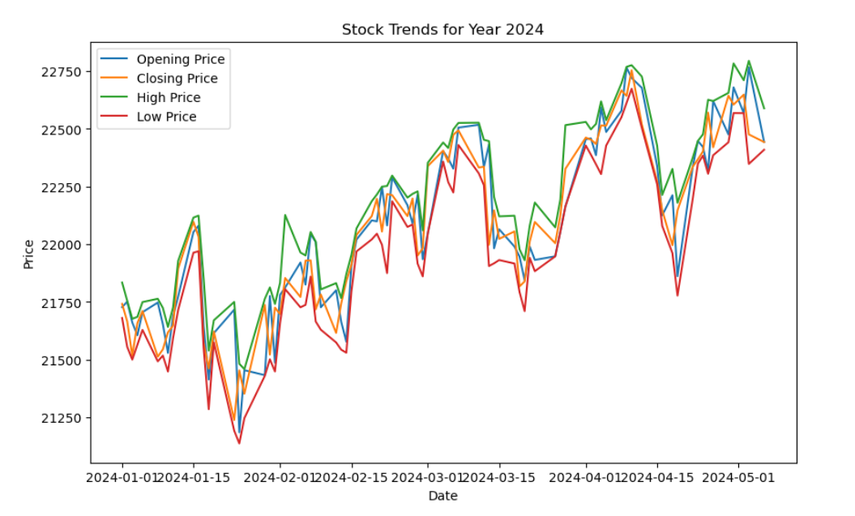
Year - 2024

Slide 13
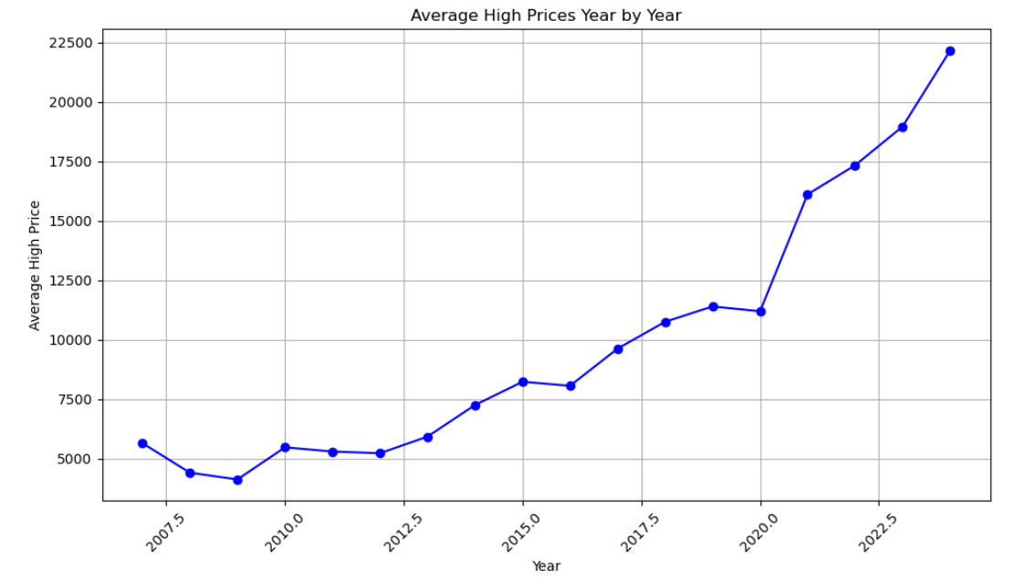
Visualize Trends For High and Low prices year by year
High Price Trend
The graph for high prices each year shows a steady increase starting from around 4500 in 2007 to a peak of 12000 in 2020. But when COVID-19 hit in 2020, the market briefly went down before bouncing back up. Since then, it's been steadily going up again each year.

Slide 14
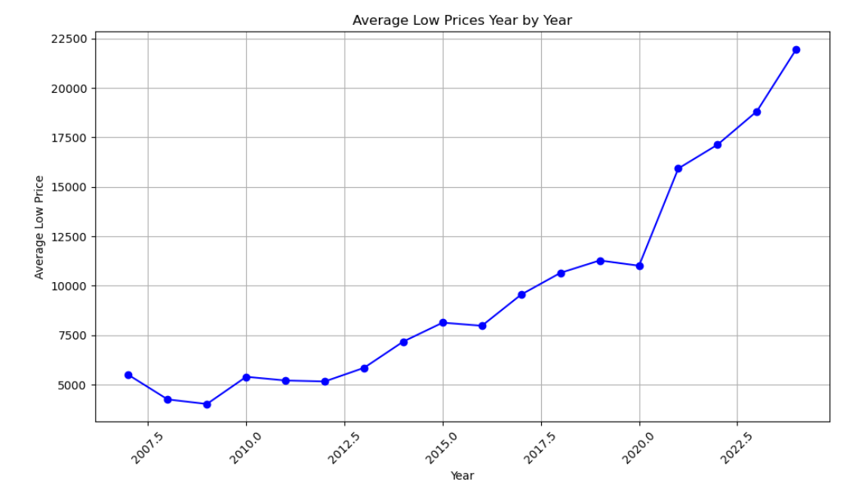
Low Price Trend
Similarly, the Low Prices Year by Year graph portrays a parallel trend. Beginning with its lowest point in 2008, prices exhibit an incremental climb annually until 2019. Despite encountering a briefecline at the outset of 2020 due to the pandemic's impact, prices swiftly resumed their upward trajectory, culminating in a peak of 21000 by 2024.

Slide 15
Bivariate analysis
Bivariate Analysis: It delves into the relationship between two variables.
Scatter Plots: These visualize the relationship between two continuous variables, helping understand how they change together.
Line Plots: These aid in identifying trends, patterns, and outliers over time or across different values of the independent variable.

Slide 16
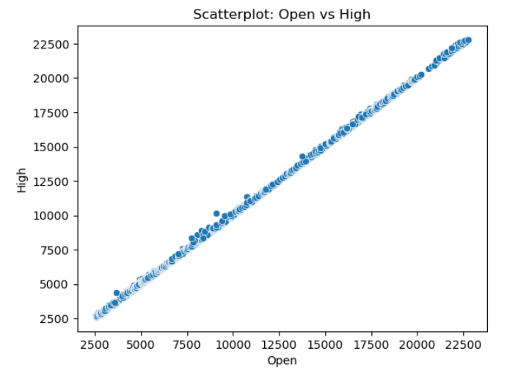
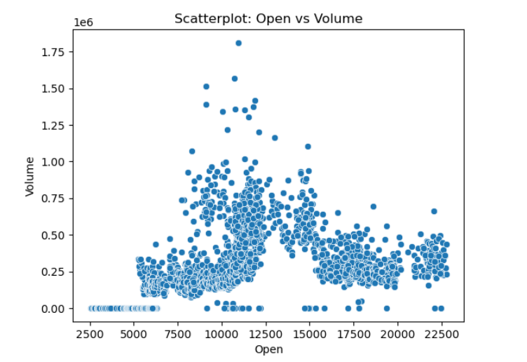
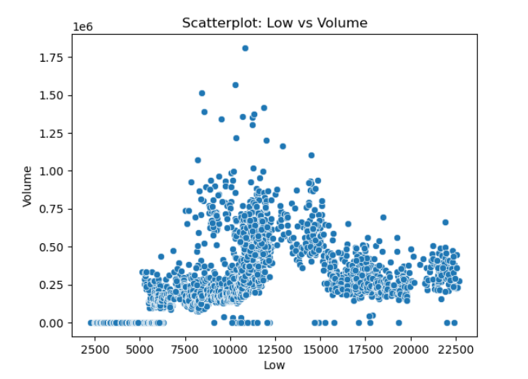
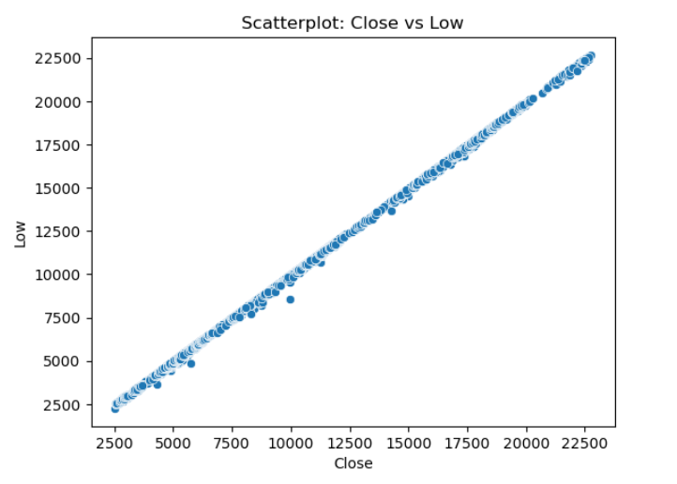

Slide 17
Analysis
Bivariate scatter plots between open, low, high, close, and volume columns offer insights:
Open vs. Close: Shows opening and closing price relationship, revealing trading session patterns.
High vs. Low: Illustrates price range fluctuations during sessions.
Open vs. Low: Indicates lowest traded price compared to opening.
Open vs. High: Highlights highest traded price compared to opening.
Close vs. Low: Shows closing price relation to session lows.
Close vs. High: Demonstrates closing price relation to session highs.
Volume vs. Open: Depicts trading volume relation to Open, indicating market interest.
These plots aid in understanding price movements, trading patterns, and market dynamics for informed decisions.

Slide 18
Interactive Line Chart
NIFTY50 Volume Analysis
- Sept 2007 - May 2024
- By Year (2007, 2008, 2009 etc)
- By Month (09/2007,01/2012, 02/2015 etc)
NIFTY50 Daily Open-Close Analysis
- Sept 2007 - May 2024
- By Year (2007, 2008, 2009 etc)
- By Month (09/2007,01/2012, 02/2015 etc)
NIFTY50 Daily High-Low Analysis
- Sept 2007 - May 2024
- By Year (2007, 2008, 2009 etc)
- By Month (09/2007,01/2012, 02/2015 etc)
NIFTY50 Candlestick Chart
- Sept 2007 - May 2024
- By Year (2007, 2008, 2009 etc)
- By Month (09/2007,01/2012, 02/2015 etc)
Integrating Pandemic
- Major single day falls - 2019 onwards (Covid Time) - Major single day gains - 2019 onwards

Slide 19
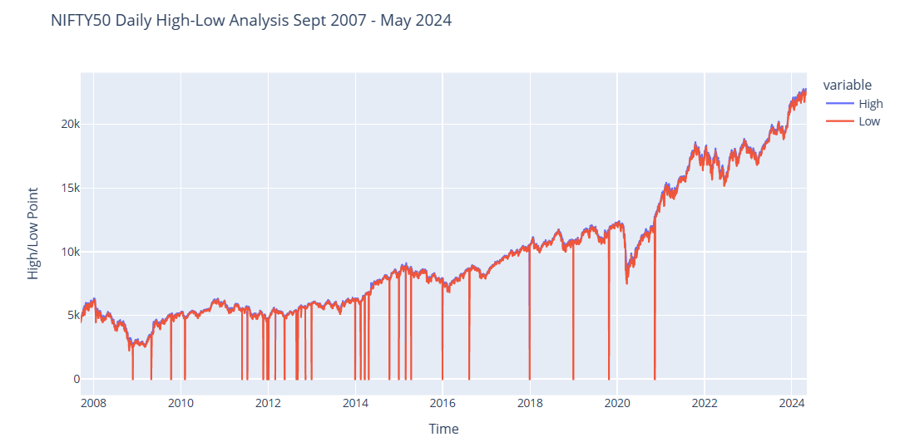
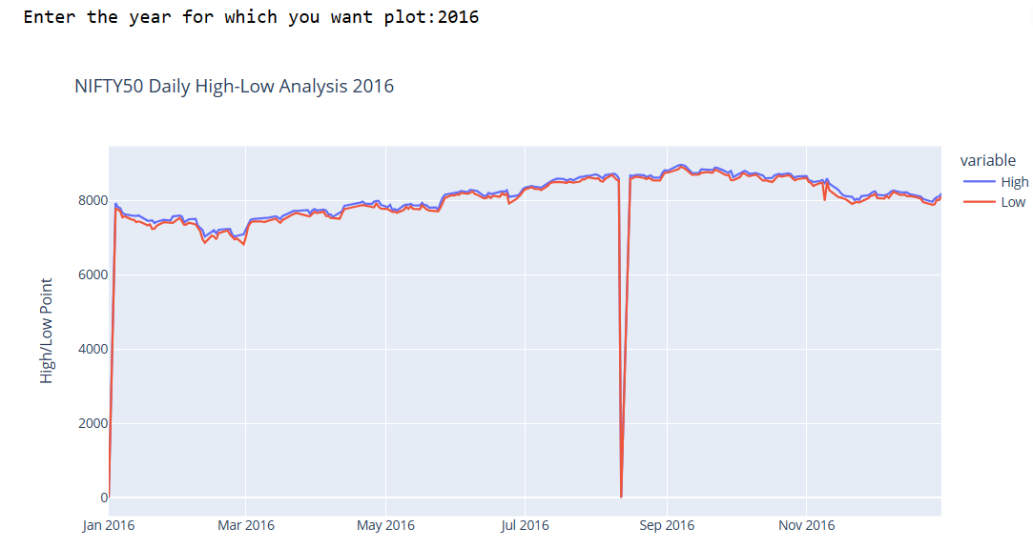
High Low Analysis
2007 - 2024
By Year

Slide 20
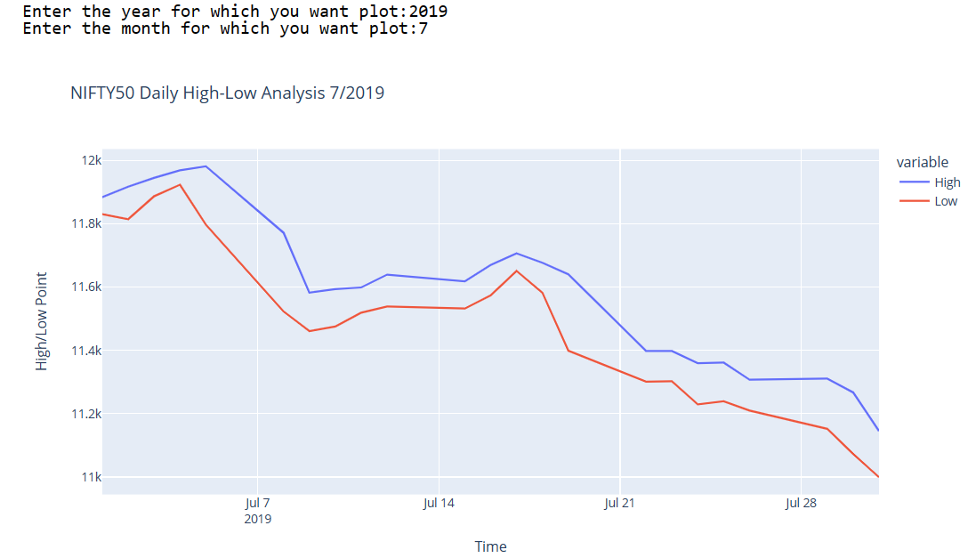
By Month

Slide 21
Model Developement
Predicting future prices in the Indian stock market hinges on LSTM models, leveraging historical data for accurate forecasts by capturing temporal patterns and market behavior insights.
Integrating real-time data, LSTM models adapt to changing conditions, enhancing accuracy and providing invaluable support for informed trading decisions.

Slide 22
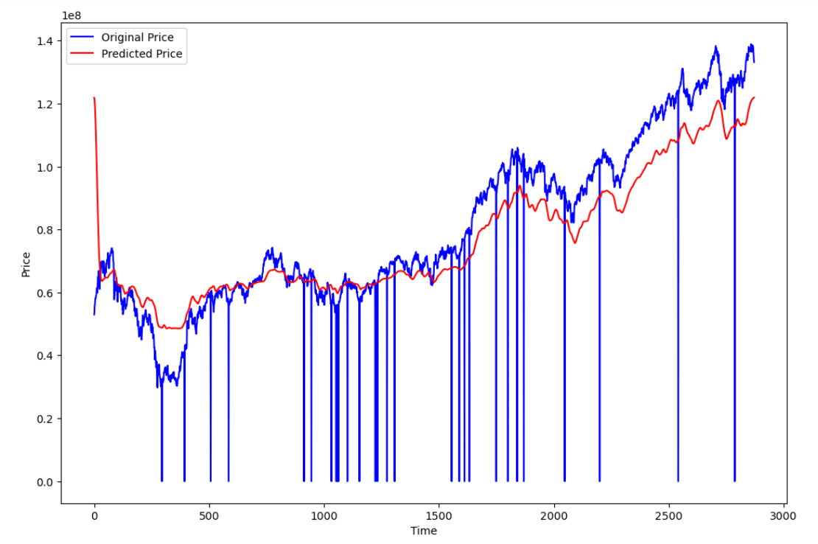
Predicted Close Price vs Original Close Price

Slide 23
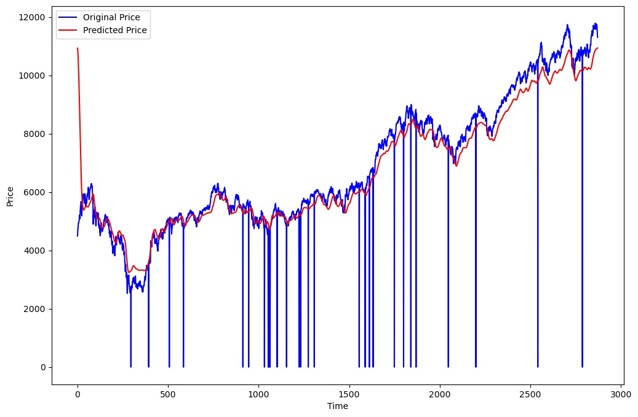
Another attempt of Predicted Close Price vs Original Close Price

Slide 24
Conclusion
In summary, our project aims to connect past and present data in the Indian stock market, empowering investors with actionable insights. By integrating real-time and historical data, we provide tools to navigate market volatility and identify opportunities. Through advanced statistical methods and technology, we uncover trends and patterns in the NIFTY 50 index, enabling informed decision-making. Our interactive visualizations facilitate deeper analysis, while consideration of the COVID-19 impact provides context for market behavior. Overall, our project equips investors with the knowledge and tools to make confident investment decisions in the Indian stock market.

Slide 25
Thank You

